Slide 1
Fuzzy Example
Real Time Strategy game
Given an advancing enemy force of a certain size, at a given distance away, how many troops do we deploy to meet the impending threat?

Slide 2
Fuzzy Example
We will set up rules to handle troop deployment using two fuzzy variables:
Distance and Force Size
We can define some fuzzy subsets:
Distance can be Close, Medium or Far
Force Size can be Tiny, Small, Moderate or Large

Slide 3
Fuzzy Example
Decide on our fuzzy output variable.
Threat Level
Decide on subsets for Threat Level
Low
Medium
High
Devise rules for mapping our fuzzy input variables to Threat Levels

Slide 4
Rule Matrix for Threat Level
Range
 | Close | Medium | Far
Tiny
Small
Moderate
Large
Force

Slide 5
Rule Matrix for Threat Level
Range
 | Close | Medium | Far
Tiny | Medium | Low | Low
Small | High | Low | Low
Moderate | High | Medium | Low
Large | High | High | Medium
Force

Slide 6
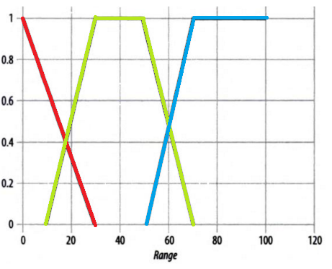
Membership - Range of Force
Close Medium Far

Slide 7
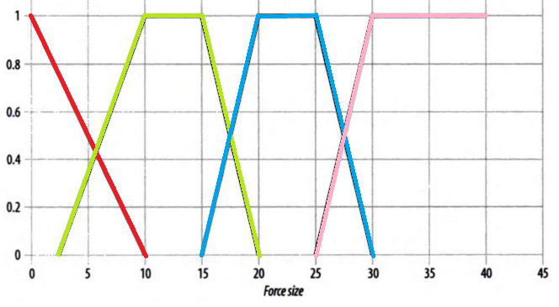
Membership - Size of Force
Tiny Small Moderate Large

Slide 8
Battle Scenario
Enemy force of 8 troops (units) at a range of 25 (units)
Result of size fuzzification gives
Tiny = 0.2
Small = 0.73
Moderate = 0.0
Large = 0.0
Result of range fuzzification gives
Close = 0.17
Medium = 0.75
Far = 0.0

Slide 9
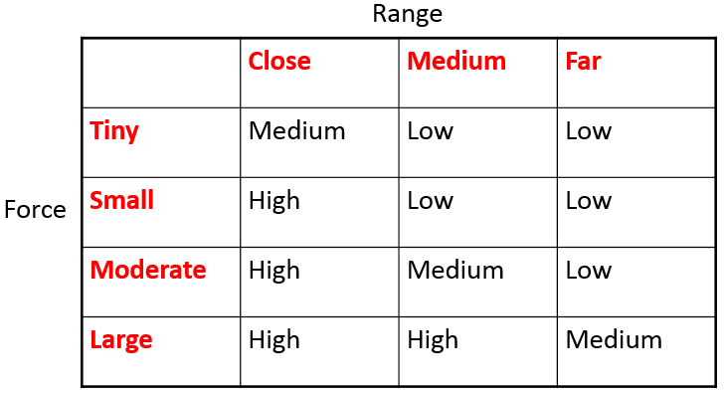
Rule Application for Threat Level
Low is
(Medium AND Tiny) OR (Medium AND Small) OR (Far AND NOT(Large) )
Medium is
(Close AND Tiny) OR (Medium AND Moderate) OR (Far AND Large)
High is
?

Slide 10

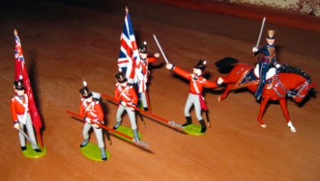
Defuzzification
We get the following degrees of membership:
Low = 0.73
Medium = 0.17
High = 0.17
Assuming the following singleton output values:
LowNum = 10 units, MediumNum = 30 units, HighNum = 50 units
Deployment is then:
(0.73 * LowNum + 0.17 * MediumNum + 0.17 * HignNum) / (0.73 + 0.17 + 0.17)
= (0.73 * 10 + 0.17 * 30 + 0.17 * 50) / (0.73 + 0.17 + 0.17)
= 19.5
~ 20
or one?

Slide 11
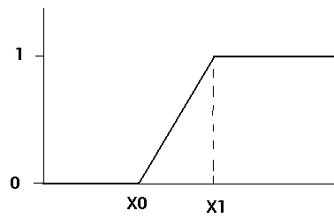
Implementation
Decide on membership functions and code:
e.g.
Double FuzzyGrade (double value, double x0, double x1)
{
double result = 0;
double x = value
if (x <= x0)
result = 0;
else if (x > x1)
result = 1;
else
result = ( (x-x0) / (x1-x0) )
return result
}

Slide 12
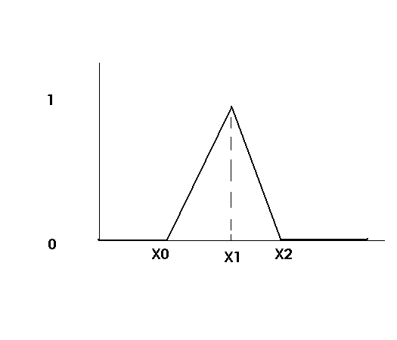
Implementation
e.g.
Double FuzzyTriangle (double value, double x0, double x1, double x2)
{
double result = 0;
double x = value
if ((x <= x0) || (x >= x2))
result = 0;
else if (x == x1)
result = 1;
else if ( (x > x0) && (x < x1) )
result = ( (x-x0) / (x1-x0) )
else
result = ( (x2-x) / (x2-x1) )
return result
}

Slide 13
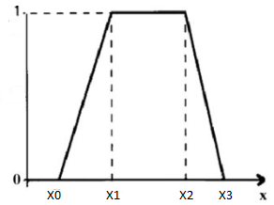
Implementation
e.g.
Double FuzzyTrapezoid (double value, double x0, double x1, double x2, double x3)
{
double result = 0;
double x = value
if ((x <= x0) || (x >= x3))
result = 0;
else if ( (x >= x1) && (x <= x2)
result = 1;
else if ( (x > x0) && (x < x1) )
result = ( (x-x0) / (x1-x0) )
else
result = ( (x3-x) / (x3-x2) )
return result
}

Slide 14
Implementation
Implement Fuzzy logical operators:
Double FuzzyAND (double A, double B)
{
return MIN(A, B);
}
Double FuzzyOR (double A, double B)
{
return MAX(A, B);
}
Double FuzzyNOT (double A)
{
return 1.0 - A;
}

Slide 15
Implementation
For our threat assessment:
- Enemy force of 8 troops (units)
mTiny = FuzzyTriangle(8, -10, 0, 10);
mSmall = FuzzyTrapezoid(8, 2.5, 10, 15, 20);
mModerate = FuzzyTrapezoid(8, 15, 20, 25, 30);
mLarge = FuzzyGrade(8, 25, 30);
- Enemy force at a range of 25 (units)
mClose = FuzzyTriangle(25, -30, 0, 30);
mMedium = FuzzyTrapezoid(25, 10, 30, 50, 70);
mFar = FuzzyGrade(25, 50, 70);
Fuzzy Set | Degree of Membership
Close | 0.17
Medium | 0.75
Far | 0.0
Tiny | 0.2
Small | 0.73
Moderate | 0.0
Large | 0.0

Slide 16
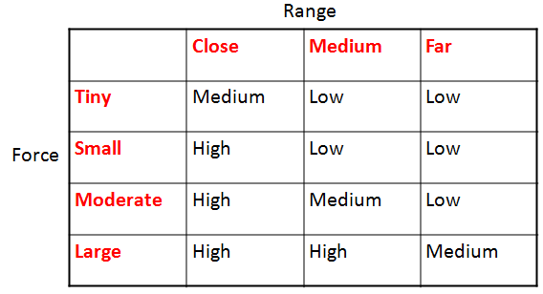
Implementation
Recall our rule matrix:
So now we can do:
mLow = FuzzyOR( FuzzyAND(mMedium, mTiny), FuzzyAND(mMedium, mSmall) );
mMedium = FuzzyAND(mClose, mTiny);
mHigh = FuzzyAND(mClose, FuzzyNOT(mMedium) );
=>
mLow = 0.73
mMedium = 0.17
mHigh = 0.17

Slide 17
Implementation
Defuzzification:
nDeploy = ( mLow * 10 + mMedium * 30 + mHigh * 50 ) /
( mLow + mMedium + mHigh )
~ 20
Trial in game play and tune:
Use different singleton values
Change shape of membership functions
Introduce more fuzzy sets
Add a random element?

